Slide 1



Telerik Testing Framework
Telerik Testing Framework, SpecFlow and BDD
Dimitar Topuzov
QA Engineer
TeamX6
Telerik QA Academy

Slide 2

Table of Contents
Telerik Testing Framework
Introduction
TTF in Action (Demo)
Behaviors Driven Development
BDD Intro and Theory
SpecFlow (a BDD Tool)
TTF and SpecFlow (Demo)

Slide 3
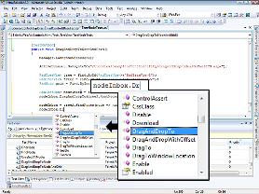
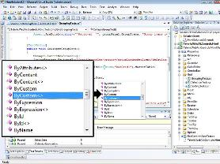
Telerik Testing Framework

Slide 4
Telerik Testing Framework
What is Telerik Testing Framework
Free Testing Framework
Support Web (HTML, JavaScript, Ajax, …)
Support Silverlight Applications
Support WPF Applications
Include some nice extras like
Element Identification Using LINQ
Wrappers for Telerik Rad Controls
VsUnit/NUnit/MbUnit/XUnit Integration

Slide 5
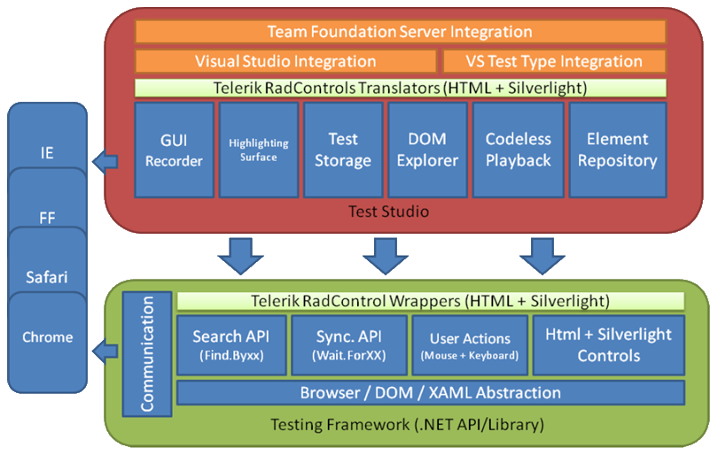
Telerik Testing Framework vs. Test Studio

Slide 6
Telerik Testing Framework
Telerik Testing Framework
+
Visual Studio and C#
=
Expectedly Good Combination!

Slide 7

Telerik Testing Framework
Why it is good combination?
TTF for interaction with Web and WPF
C# for everything else
Industry leading IDE to write your tests

Slide 8
Telerik Testing Framework
When it is great solution?
Testing involves a lot of non UI actions
Example: Check logs of server after some UI actions in frontend
Testing complex SUT build with multiple technologies
Example: TTF can be integrated with other testing frameworks
Overwhelm limitations of Test Studio UI
Example: Test similar WPF and Silverlight apps with the same code

Slide 9
Telerik Testing Framework
When it is NOT great solution?
No codding skills
Then you need a coddles tool like Test Studio
No time to develop coded automation
Usually recording tests is faster so initial implementation cost is lower
Usually writing tests in code is slower, but it pays of with less support effort and better flexibility

Slide 10
Telerik Testing Framework
What else we need?
Appropriate DOM Explorer
What DOM Explorer I can use?
Test Studio’s Build-in DOM Explorer
Firebug and Browser’s Build-in Tools
XAML Spy
WPF Inspector
Snoop

Slide 11
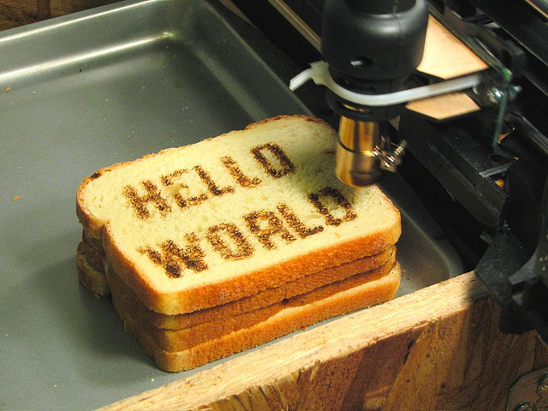
Telerik Testing Framework
DEMO
Notes:
Demos should be delivered in parallel with slides presentation.

Slide 12
Behavior Driven Development
WHEN
(When the event occurs)
GIVEN
(Set of Pre-conditions)
BDD
THEN
(Outcome is achieved)
BDD, Gherkin Syntax and SpecFlow

Slide 13

Bike Example
Let’s write some tests that test a bike
Verify pedals are available
Verify breaks are available
Verify seat is available
Verify bike has two tires

Slide 14
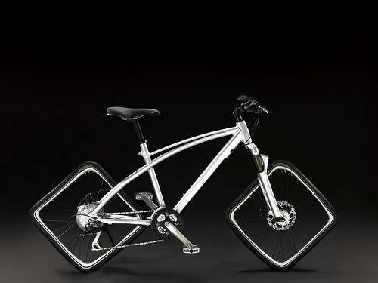
Bike Example
Is it a Bike?
Pedals
Breaks
Seat
Two Tires
It is a useless bike!

Slide 15
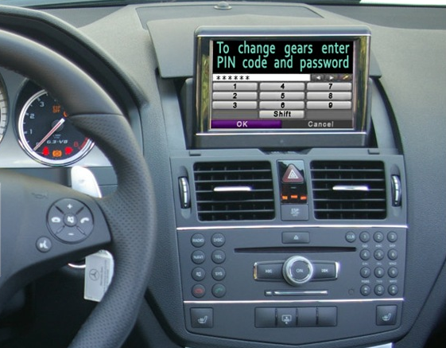
Useless Car Example

Slide 16

The Problem
What happened?
ITs are not Domain Experts
Domain Experts don’t know the technology
Bad communication
Bad documentation

Slide 17
The Solution
How to solve the problem?
Make sure Acceptance Criteria is defined by Domain Experts
Make sure Domain Experts and ITs talk the same language
Make sure you have Single Source of Truth
Illustrate requirements using examples
Automate those examples

Slide 18
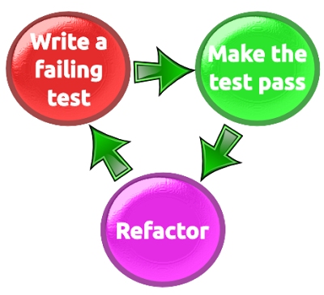
Back to the Roots
Test Driven Development in picture:
Usually TDD = Unit tests written from developer for his/her own code
Usually result in “confirmation that the system does what it does”

Slide 19
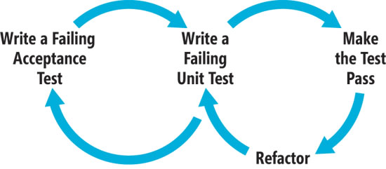
Behavior Driven Development
BDD in picture:
Based on TDD
Focusses on behavior of the product

Slide 20

Behavior Specifications
Title (one line describing the story)
Narrative:
As a [role]
I want [feature]
So that [benefit]
Acceptance Criteria: (presented as Scenarios)
Scenario 1: Title
Given [context]
And [some more context]...
When [event]
Then [outcome]
And [another outcome]...
Scenario 2: ...

Slide 21
Scenario Example
Scenario: Divide by zero
Given clean calculator
When enter 1
And click divide button
And enter 0
And click equal button
Then the result should be
Cannot divide by zero

Slide 22
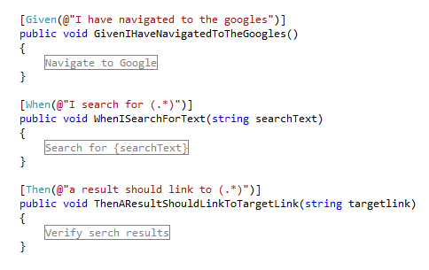
SpecFlow
Binding business readable behavior specifications to the underlying implementation

Slide 23
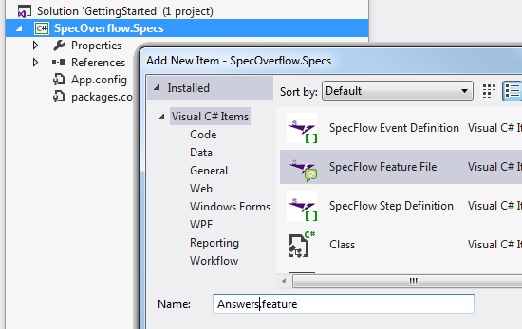
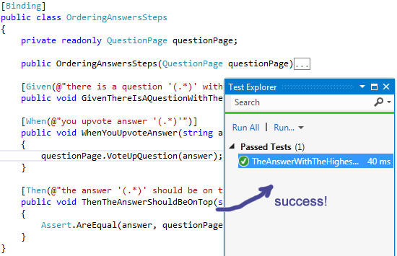
SpecFlow
DEMO
Notes:
Demos should be delivered in parallel with slides presentation.

Slide 24
Telerik Testing Framework & SpecFlow
?
?
?
?
?
Questions?
?
?
?
?
?
?

Slide 25
Exercises
Test search on http://telerikacademy.com/ with TTF and Specflow
Create simple tests
Create tests with scenario outline
Example:
Search for "Quality Assurance" return 3 cources and 1 track
Search for "webaii" does not return results

